Slide 1
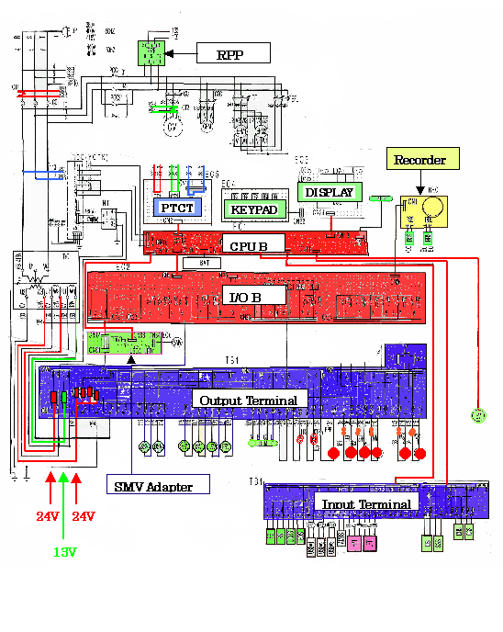
WIRING DIAGRAM
RPP
High Voltage
BAT
High Voltage
MODEM
EC7
Low Voltage
BL1
Low Voltage
SMV Adapter
WPS
CBS
RSY
Hus

